Slide 1






Unlocking
the Art of Writing
Analyzing Behavioral Patterns for Enhanced Writing Quality Assessment
Notes:
Hello !
Welcome to 'Unlocking the Art of Writing: Analyzing Behavioral Patterns for Enhanced Writing Quality Assessment.' In our fast-paced world, writing remains a critical skill. Today, we embark on a journey to understand the hidden patterns behind writing that influence its quality. Our goal is to revolutionize how we assess and improve writing, shedding light on the behaviors and cognitive activities that affect the Quality of writing.

Slide 2

Introduction
Analyzing writing behaviors
Complex Process
Involves multitude of actions and cognitive activities
Hidden dynamics behind writing
Notes:
In this exploration, we delve into the intricate world of writing behaviors. Writing is far more than just words on a page; it's a complex process entailing numerous actions and cognitive activities. In this project, we plan to uncover the hidden dynamics that shape the art of writing.

Slide 3

Have you ever wondered if those small actions, pauses, and revisions
could be the key to enhance writing quality?
Notes:
Now, it's time for a question to our audience
Time to think about!

Slide 4
Problem Statement
Does typing behavior effect the outcome of an essay?
Notes:
One critical question we aim to address is whether typing behavior has a significant impact on the quality of the final essay. Are the nuances in how we type reflected in the writing outcome?

Slide 5





The Team
Sowmya Bathula
Harshitha G.S.
Ashish Agarwal
Shaagun Suresh
Project Manager/ Data Scientist
Data Engineer
Data Analyst
ML Engineer
Notes:
Welcome to our team. It's me Ashish serving the role of project manager and data scientist. Somya working as a data engineer, Harshita as a data analyst and shagun, the ML engineer.

Slide 6


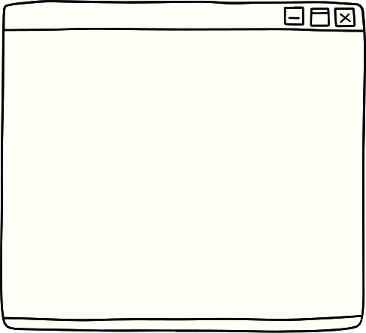




Data Source and Distribution
Large dataset of keystroke logs capturing writing process features.
The dataset is taken from Kaggle .
Notes:
Talking about data, we have sourced our data from Kaggle. It's available freely and has decent description about the data we are dealing with. The data structure is a csv file containing log records of keystrokes and mouse events. We'll get to know more about the data in coming slides.

Slide 7
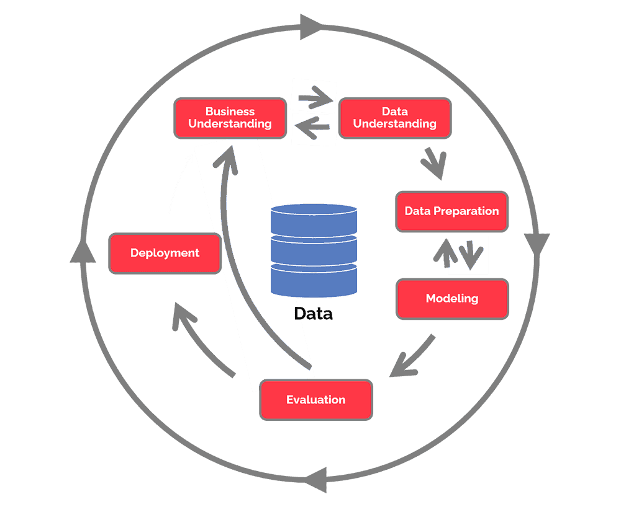
CRISP-DM METHODOLOGY
Notes:
Now, let's explore our approach using the Cross-Industry Standard Process for Data Mining, or CRISP-DM. This structured framework will guide us through Business Understanding, data understanding, data preparation, modeling, evaluation, and deployment. We'll follow these steps to unravel the secrets hidden in the keystroke logs and understand their impact on writing quality.

Slide 8
BUSINESS UNDERSTANDING
Why do we care ?
1
2
3
Empowering Intelligent Tutoring and grading Systems
Skill Assessment
Aiding Educational and
Research Institutions
Offering a comprehensive tool for assessing and improving various skills
Fostering cross-disciplinary research with global impact.
Supporting educational institutions in optimizing teaching methods.
Enhancing students' writing skills and learning outcomes.
Empowering individuals to enhance their abilities and reach their potential.
Notes:
Why is this research essential? Well, there are several compelling reasons. First, it enables us to empower intelligent tutoring and grading systems, transforming the way we educate and assess writing.
Second, our work here contributes to broader skill assessment. By providing a comprehensive tool for assessing and improving various skills, we're empowering individuals to enhance their abilities and reach their full potential.
Finally, we're aiding educational and research institutions. Our research fosters cross-disciplinary collaboration with global impact, pushing the boundaries of what we know about the writing process and its relationship to writing quality.

Slide 9

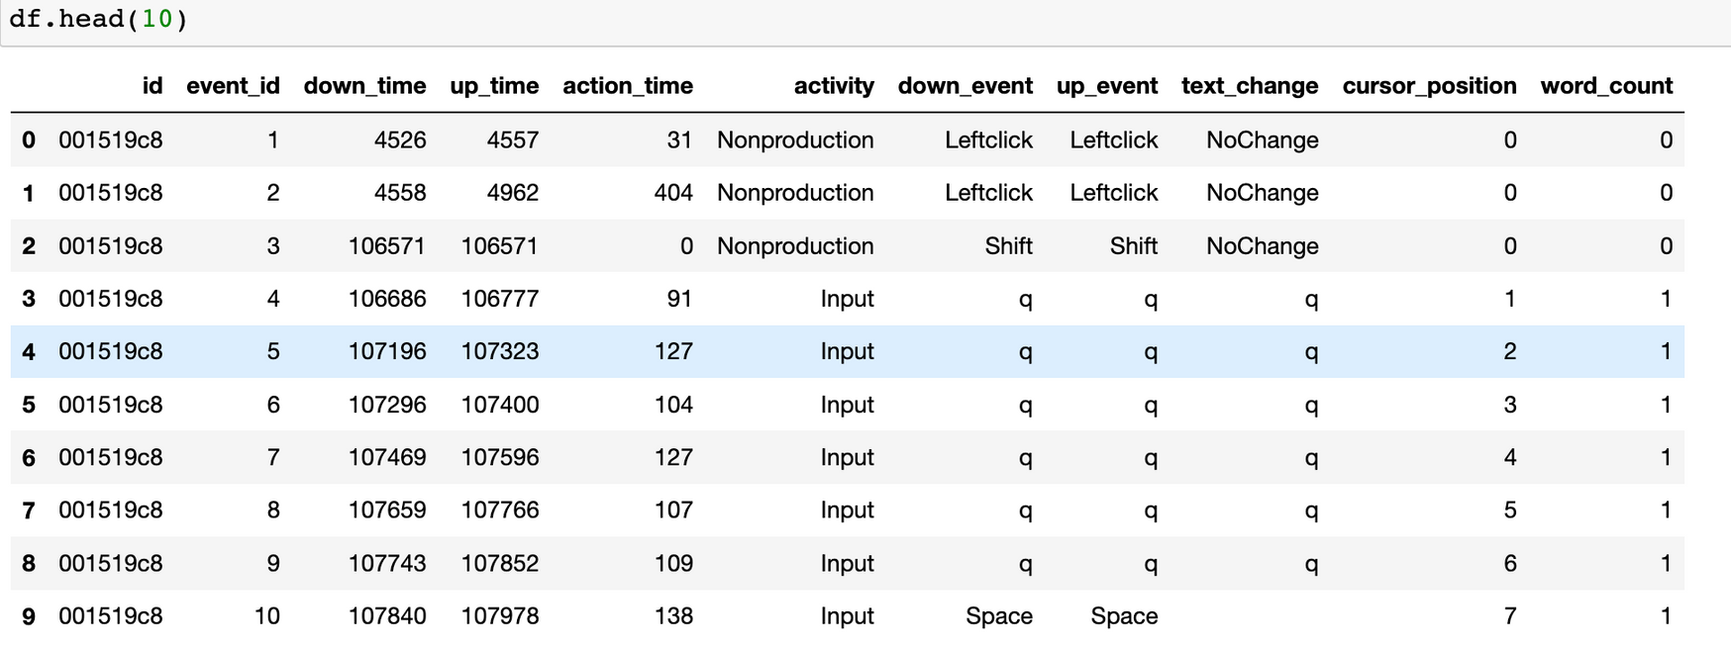

DATA UNDERSTANDING
Notes:
The current slide presents a snapshot of the data that drives our project. This Pandas dataframe provides a glimpse into the keystroke logs and process features.

Slide 10



DATA PREPARATION
Data
Transformation
Identifying
Outliers/Removing
Data Cleaning
Feature Engineering
Data Augmentation
Notes:
Data preparation is the foundation of our analysis. Our pipeline includes cleaning, transforming, removing outliers, augmenting data, and engineering features. This meticulous process ensures that our data is ready for analysis.

Slide 11

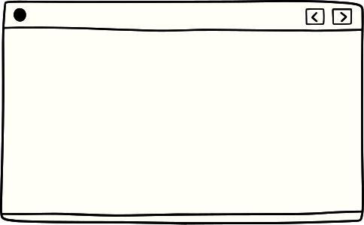



Modeling
Using various traditional and non-traditional ML algorithms
Using regression as well as classification approach
Logistic regression, random forests, decision tree, SVM, KNN, Linear regression etc.
Neural Networks, NLPs, deep Learning etc.
Notes:
In the modeling phase, we explore a variety of techniques, both traditional and cutting-edge, to analyze the data. This includes employing regression and classification approaches with algorithms such as logistic regression, random forests, as well as exploring the capabilities of neural networks, NLP, and deep learning methods. Our goal is to find the most effective model for our analysis

Slide 12

EVALUATION
Evaluate results
Review process
Determine next steps
Notes:
In the evaluation phase, our pipeline involves a structured process to evaluate the results, review the analysis, and determine the next steps. This iterative approach allows us to continuously refine our model and gain deeper insights.

Slide 13
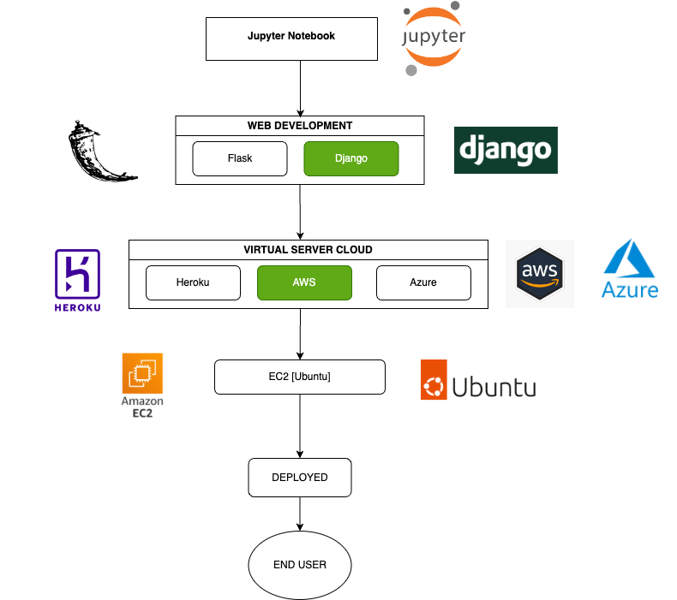
DEPLOYMENT
Notes:
Our deployment pipeline is designed to bring our analysis to the end user effectively. We leverage Jupyter Notebooks for interactive exploration and visualization; Building and testing models. Django for web development, and deploy on AWS EC2 service to ensure a seamless user experience

Slide 14



Any Questions ?
Notes:
Thank you for your valuable attention. Now, we'd be happy to address any questions you may have.
Please feel free to contact us about our project, methodologies, or any other aspects you're curious about.

Slide 15
Thank you

